Slide 1

Sync or Async
The aha moment

Slide 2




Who am I
Shirak Avakian
Director/Chief Solution Architect
worktray
Connect
@ShirakAvakian
ShirakAvakian@gmail.com

Slide 3
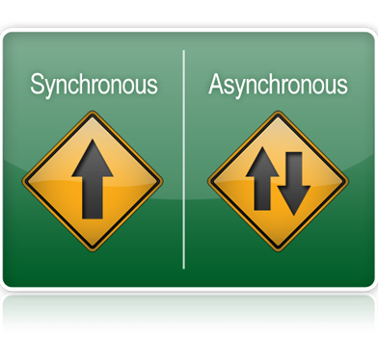
Goal and Objective
Understanding sync-a-sync
What problem is async solving
How does it work
When to use not to use
ColdFusion RunAsync
Async for client and server applications

Slide 4
1. Understanding sync-a-sync
Validate
0.2
Send Email
0.8
Save to database
1.0
A synchronous operation blocks a process till the operation completes
An asynchronous operation is non-blocking and only initiates the operation
Validate
0.2
Send Email
0.8
Save to database
1.0

Slide 5
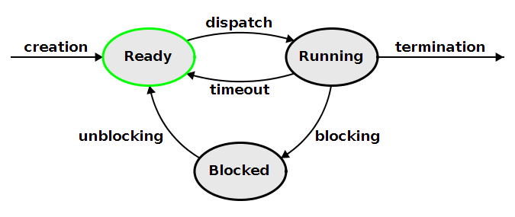
2. What problem is async solving?
Problem of “long running operations”
How the computer’s CPU executes the code in your application?
Thread of execution
Blocking – when the thread is busy doing stuff (or waiting on stuff)
Two types of blocking:
CPU-bound blocking operations. (Mathematical operations, games)
IO-bound (In/Out) blocking operations. When your code rely on external resources: - Hard drive / folder / file system access - Network access

Slide 6
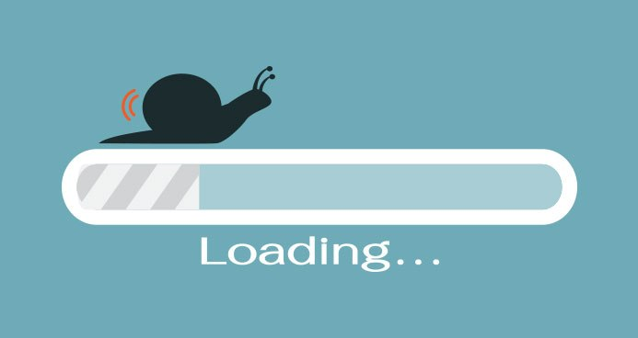
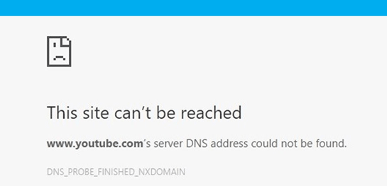
What is the impact of blocking operations?
Client applications Worst case: lack of responsiveness To minimize the impact: Progress bars/Spinners
Server applications Web server (keep a pool of CPU thread) Worst case: no server response To minimize the impact: scale the server

Slide 7
3. How does it work?
5
Start
funcA()
Start
funcB()
Await(idle) for funcA result
finish
funcA()
Start/Finish
funcC()
Finich
funcB
Await(idle) for funcB result
HTTP Request A
1- Async/await for a result in (future)
1- funcA() start @ 11:00:00 AM
1.1 Make async http request A to external service(5.0) sec
2- funcB() start @ 11:00:00 AM 2.1 Make async http request B to external service (15.0) sec
3- Thread waiting for funcA to complete
4-funcA completed @ 11:00:05 AM
5- funcC() started @ 11:00:05 AM (total execution 5.0 sec)
6-Thread waiting for funcB() to complete (Thread will wait another 5.0 sec)
7- funcB() will complete @ 11:00:15 AM
15
HTTP Request B
5

Slide 8
3. How does it work?
Start
funcA()
Start
funcB()
Start/Finish
funcC()
HTTP Request A
Finish A
2- Async (run and forget)
5
1- funcA() start @ 11:00:00 AM
1.1 Make async http request A to external service(5.0) sec
2- funcB() start @ 11:00:00 AM 2.1 Make async http request B to external service (15.0) sec
3- funcC() started @ 11:00:00 AM (total execution 5.0 sec)
6-Thread will complete @ 11:00:05 AM
HTTP Request B
Finish B
15
5

Slide 9
4.When to use not to use
1- Do not use async
2- Use async
For simple and basic computations or short running operations.
When you have a single database server not utilizing connection pooling.
For Sequential tasks, where stopping the entire program to wait for a network request or disk IO makes sense.
To make your client application responsive.
When you can run multiple code blocks in parallel mode.
When you are interacting with external server provider.
When you have tasks independent from each other.
When you can run other tasks while waiting for a long running task to complete.

Slide 10
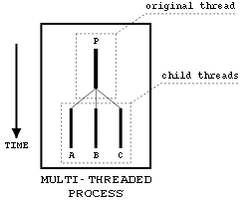
5.ColdFusion RunAsync()
Is asynchronous programming new to ColdFusion?
No
Is CFTHREAD asynchronous?
Yes
Is CFML event gateway asynchronous?
Yes
Why RunAsync()?
While cfthread & event gateway does the job to execute the code asynchronously, there are issues:
1- Not easy to manage
2- Not easy to catch errors
3- Confusion when joining threads
4- Confusion between thread-local scope, thread scope, and attributes scope.

Slide 11
5.ColdFusion RunAsync()
A function that returns a Future object
A Future is an eventual result of an asynchronous operation.
Can run as async mode only or async/await
Methods available with runAsync are:
cancel();
error(callback, timeout);
error(callback);
get();
get(timeout
isCancelled();
isDone();
then(callback);
then(callback, timeout);
Any time you use future object, your page thread will wait for async result.

Slide 12
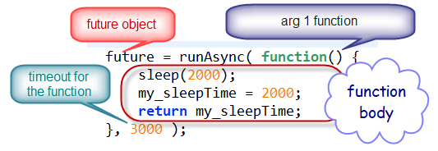
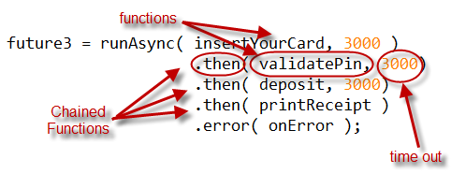
5.ColdFusion RunAsync()
Understanding runAsync():
Anytime you runasync() within cfm page, you are creating new thread separate from the main thread. If you use future result, you main thread will wait async execution to complete.
Understanding then():
Then method will chain sequential process within async process.
Understanding error():
Error method will execute whenever error occur in any of chained functions. Once error method used, the main thread will wait until the entire async chain of methods execution completed.
Cancel() isCancelled() isDone():

Slide 13
DEMO 1
http://localhost/CFSummit2018/src/Demo01/no-async.cfm
http://localhost/CFSummit2018/src/Demo01/async.cfm
http://localhost/CFSummit2018/src/Demo01/async_onError.cfm
http://localhost/CFSummit2018/src/Demo01/async_other.cfm

Slide 14
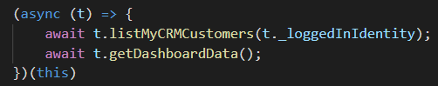
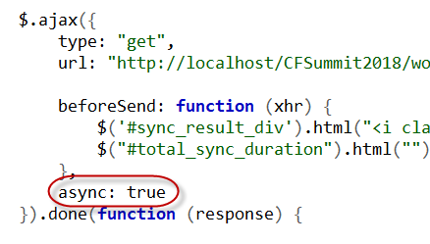
6. Async for client and server applications
A- Async for client applications
Client applications, such as web interface, mobile, windows desktop etc.. We will be focusing on html/javascript/jquery applications.
Async/await keywork
Improve performance.
Responsive user interface.
Data dependency assurance by await keyword.

Slide 15
DEMO 2
http://localhost/CFSummit2018/src/Demo01/no-async.cfm
http://localhost/CFSummit2018/src/Demo01/async.cfm
http://localhost/CFSummit2018/src/Demo01/async_onError.cfm
http://localhost/CFSummit2018/src/Demo01/async_other.cfm

Slide 16
Resources
http://www.cs.unc.edu/~dewan/242/s07/notes/ipc/node9.html
https://coldfusion.adobe.com/2018/07/asynchronous-programming-in-coldfusion-2018-release/

